Slide 1
SNAKE GAME PROJECT
MSIS2433.M11.CTTT
Lecturer: Nguyễn Thanh bình
Student: Đinh Ngọc sơn anh
Id: 18520444

Slide 2

TABLE OF CONTENTS
Introduction
How to play
Usecase diagram
Some image in game
Reference
Thanks for watching

Slide 3
INTRODUCTION
Snake game is a basic game that has many versions and everyone know it so today i choose it as my topic
Snake is the common name for a video game concept where the player maneuvers a line which grows in length, with the line itself being a primary obstacle. the concept originated in the 1976 two-player arcade game blockade from gremlin industries – wikipedia

Slide 4
HOW TO PLAY
We use the Up,Down,Right,Left keys to control the snake to move over the obstacles to eat the prey.
you can move anywhere to hunt your lips and don't hit your tail

Slide 5
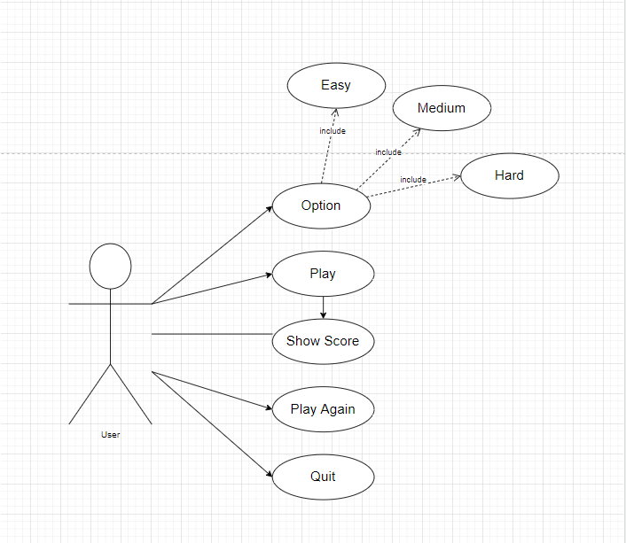
USECASE DIAGRAM

Slide 6
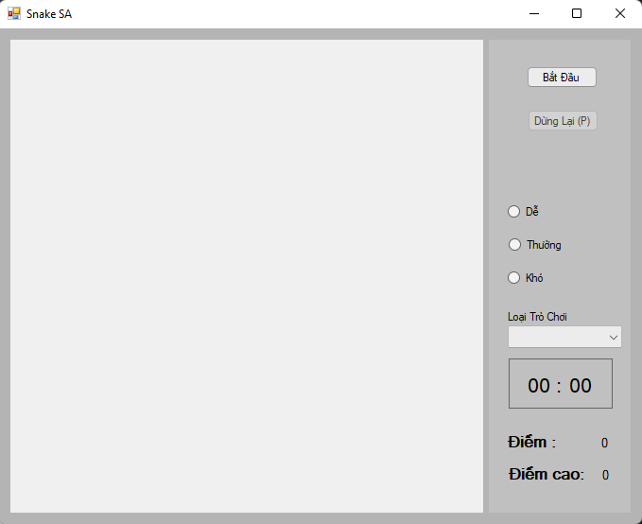
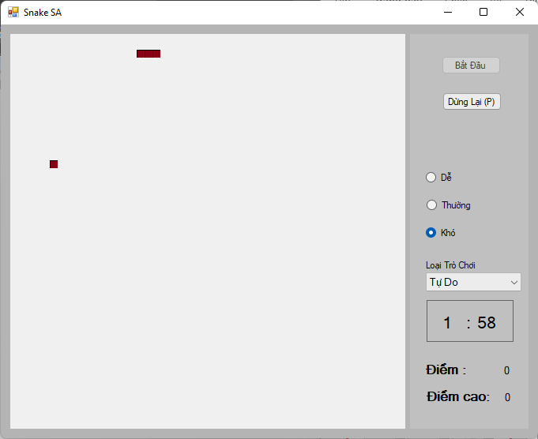
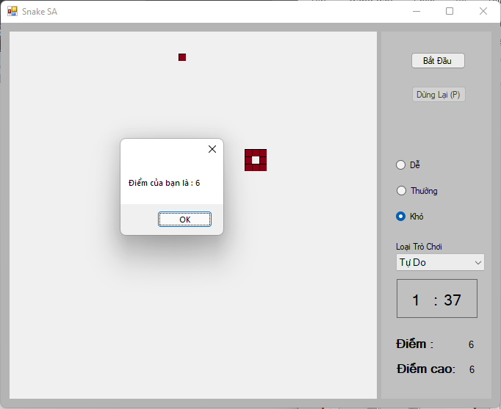
SOME IMAGE IN GAME
START
IN GAME
AFFTER GAME

Slide 7

REFERENCE
Content : https://github.com/victoriazakharo/Snake

Slide 8

THANKS FOR WATCHING

